Slide 1
ICMP
SUBTITLE GOES HERE

Slide 2
OUTLINE
Dhruv: Intro
Jash: Source Quench Message and Parameter Problem
Vaibhav: Time Exceeded Message
Suchit: Destination unreachable
Himanshu: Redirection Message

Slide 3
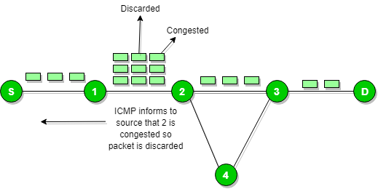
Source Quench Message
It is a request message to decrease traffic rate for messages sending to the host(destination).
ICMP will take source IP from the discarded packet and informs to source by sending source quench message.
Then source will reduce the speed of transmission so that router will free for congestion.

Slide 4
Parameter Problem Message
Parameter Problem messages are used when a host or router could not interpret an invalid parameter in an IPv4 datagram header.
ICMP will take the source IP from the discarded packet and informs to source by sending this parameter problem message.

